Slide 1
MealMate
AED Final Project
Spring 2023

Slide 2
Introduction
The Catering Management System is a technology designed to aid catering businesses in effectively managing their operations.
It offers several features to help the catering sector, including menu planning, order administration, inventory management, and compliance management.
It was made with Java Swing. Location, enterprises, organizations, user accounts, roles, work queues, and work requests are just a few of its many components.

Slide 3
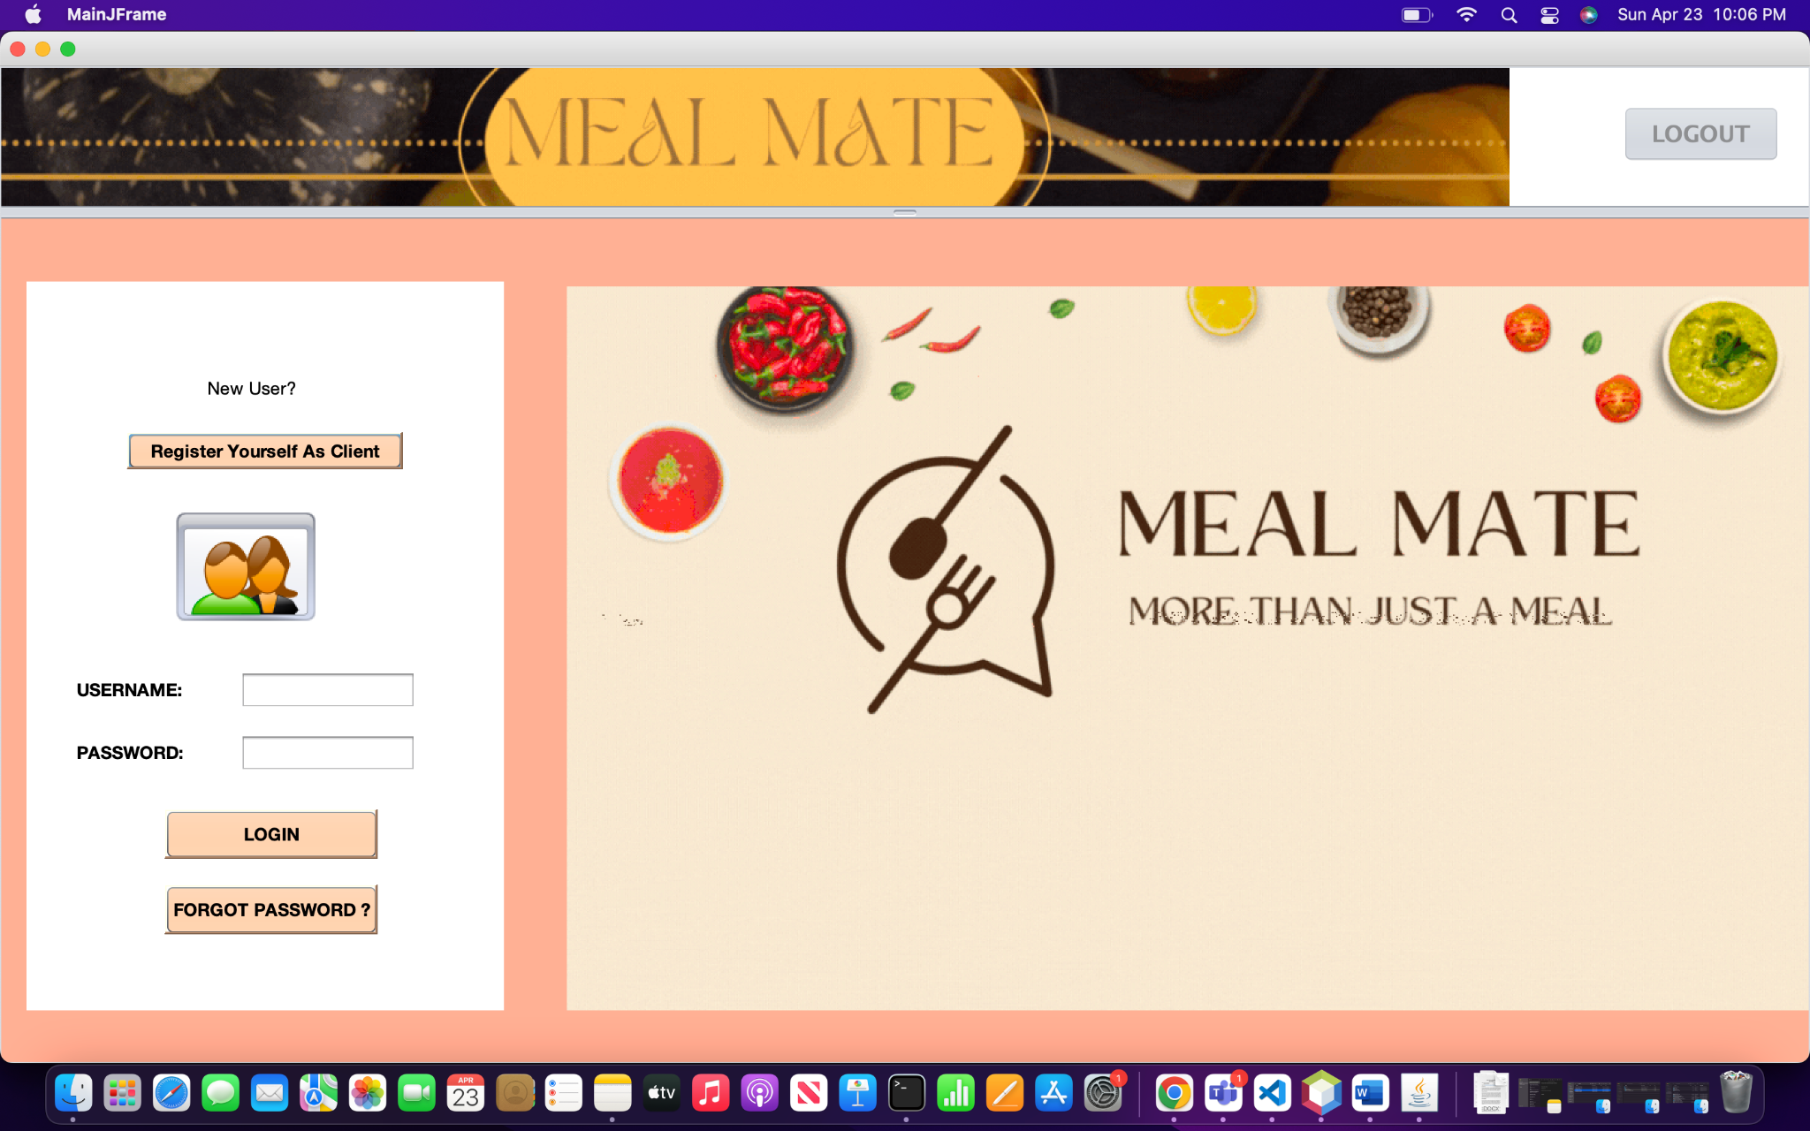
Main Screen

Slide 4
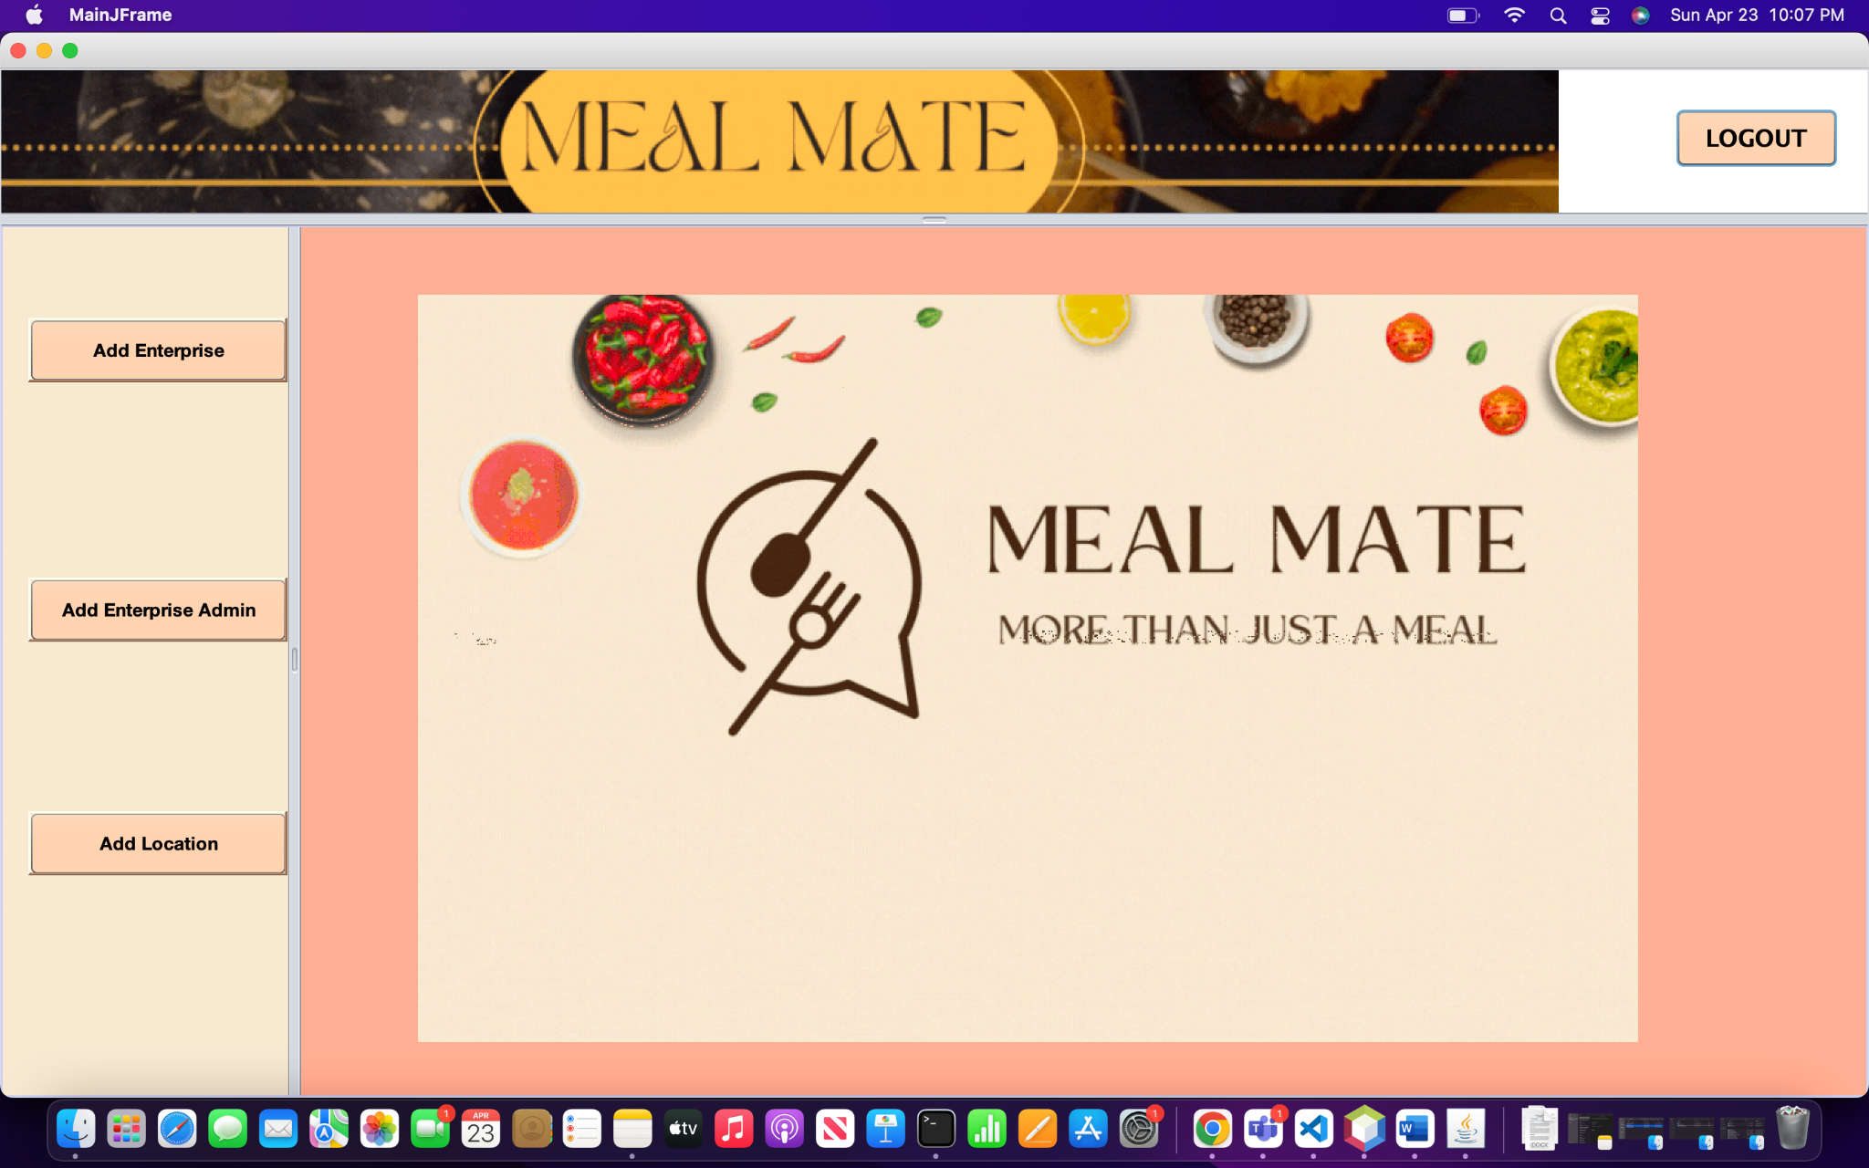
Admin Screen

Slide 5
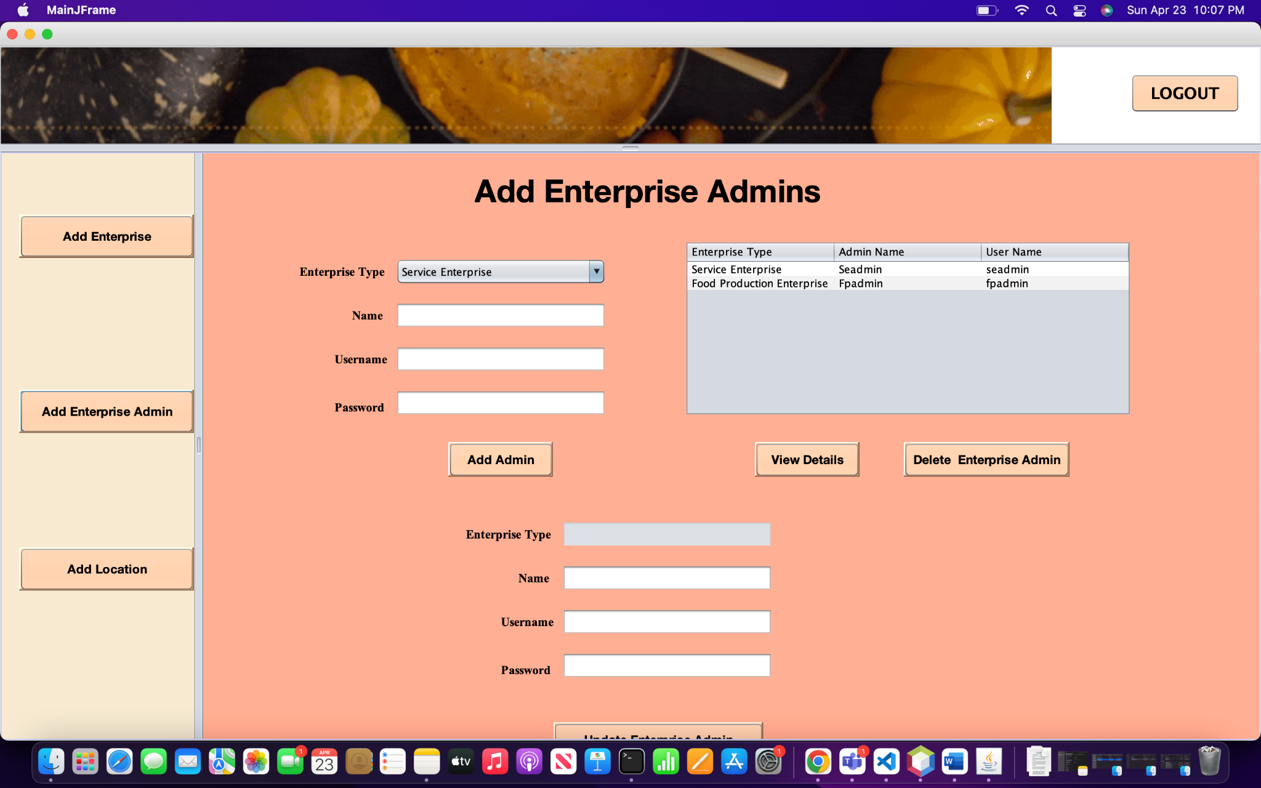
Add Enterprise Admin

Slide 6
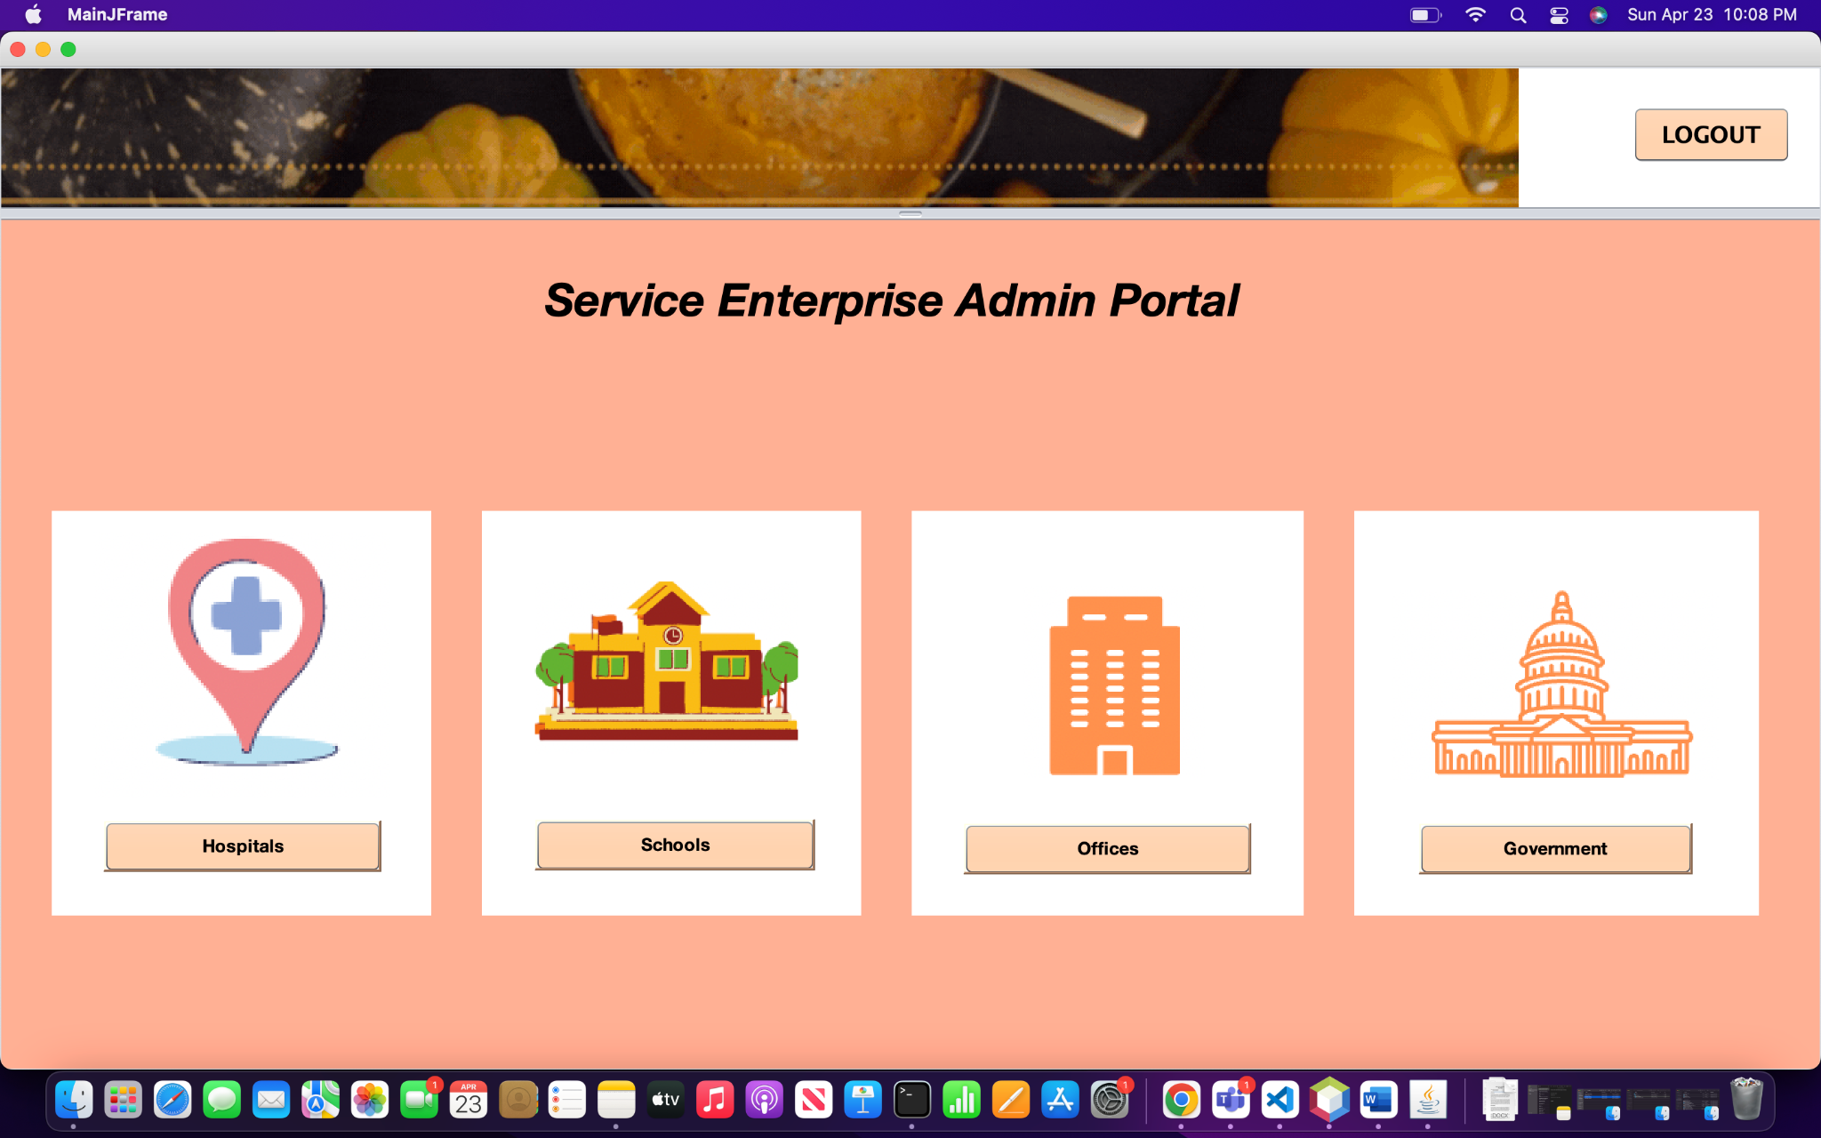
Service Enterprise

Slide 7
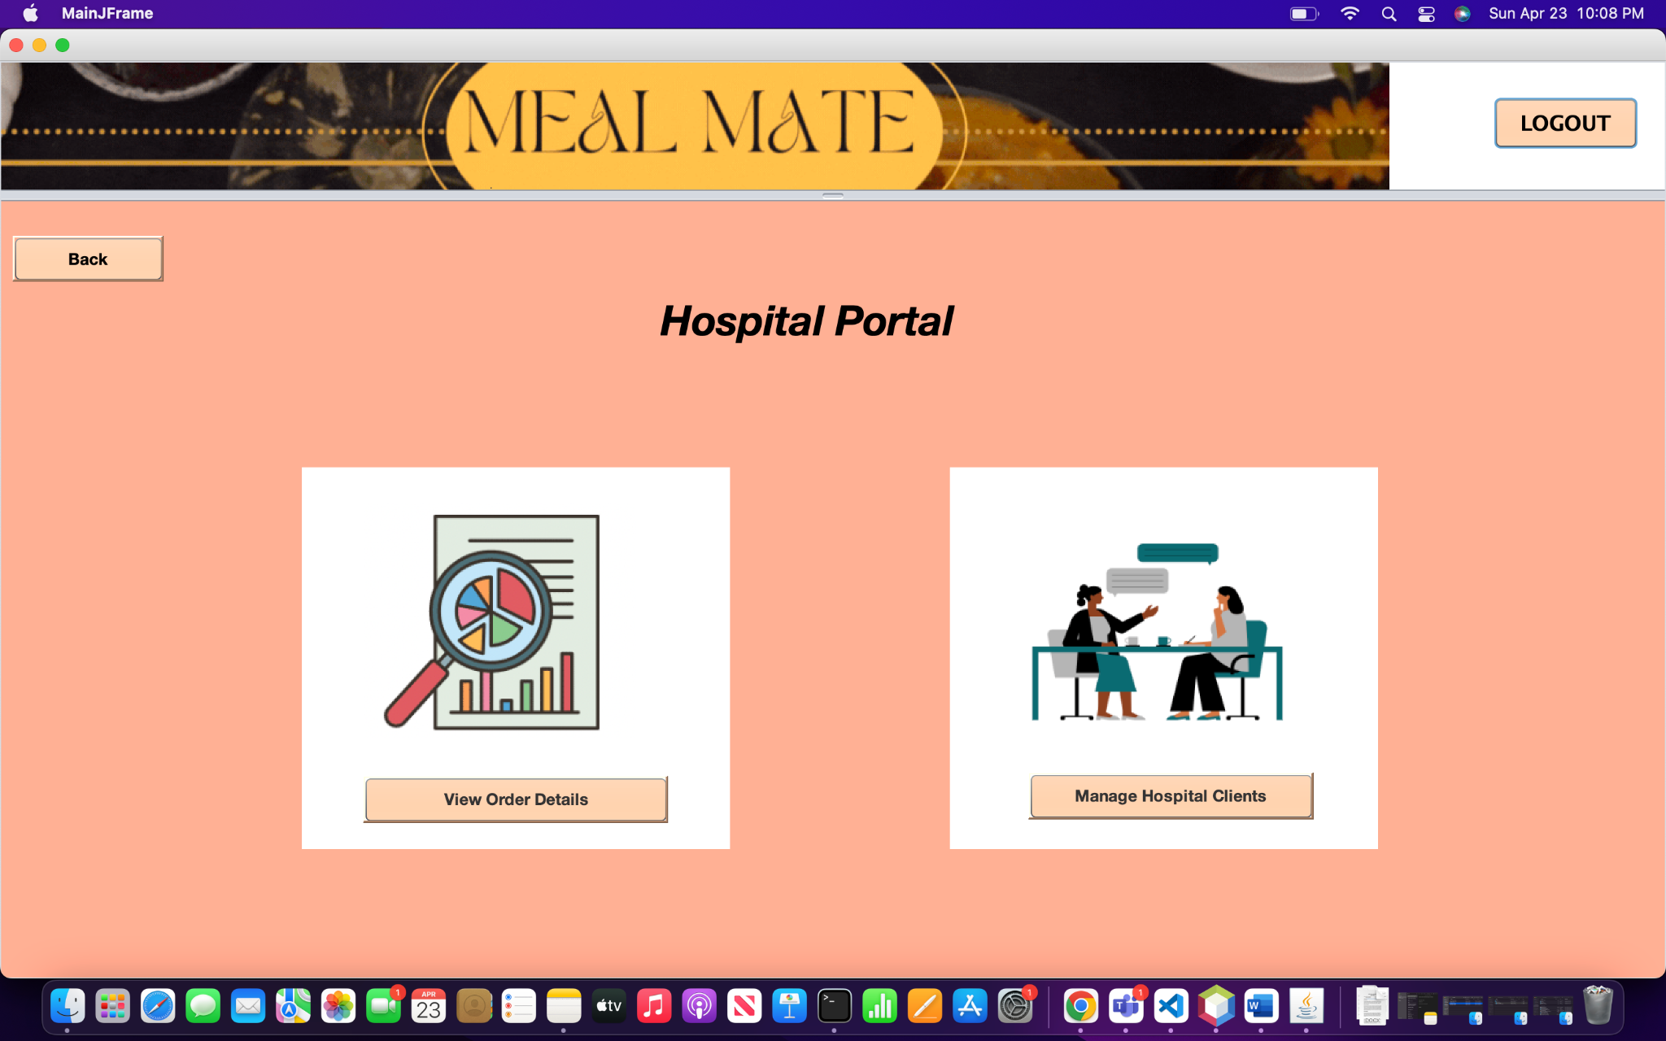
Organizations

Slide 8
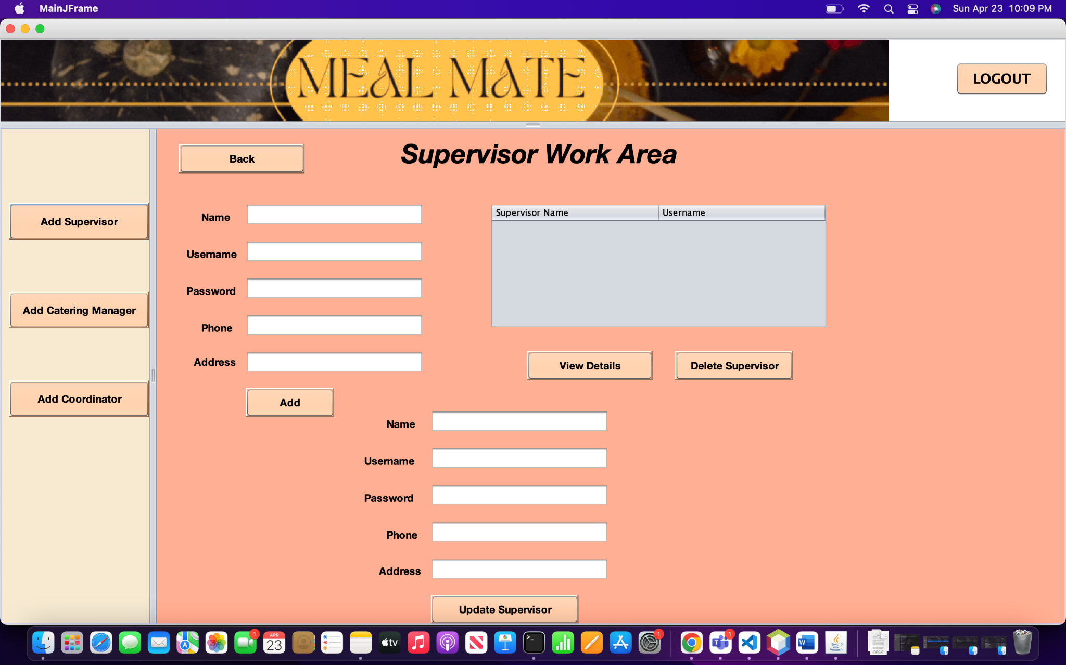
Supervisor Work Area

Slide 9
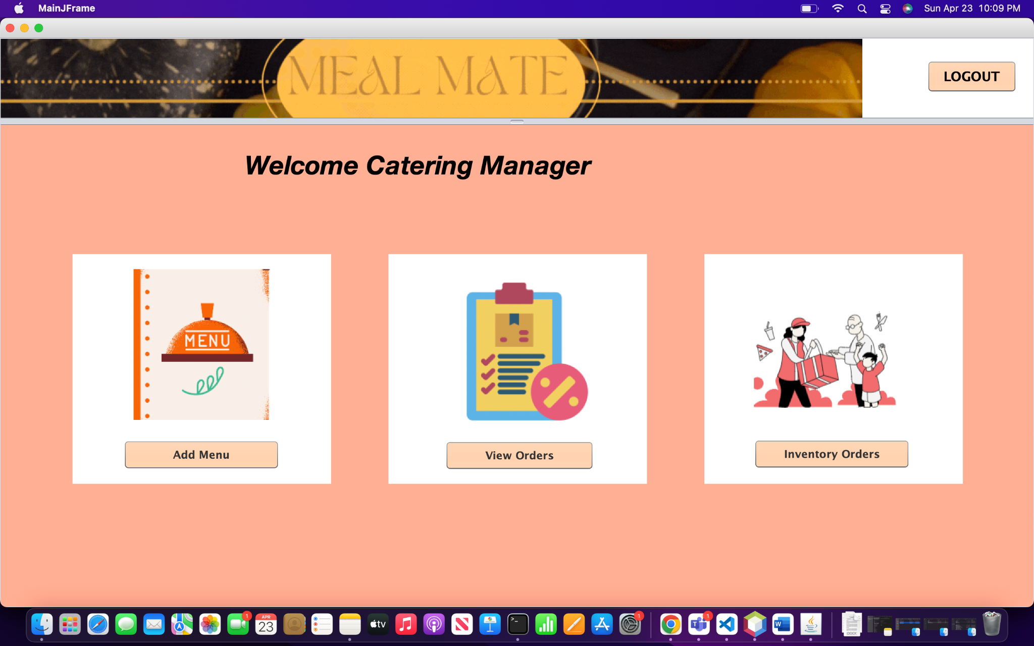
Catering Manager Work Area

Slide 10
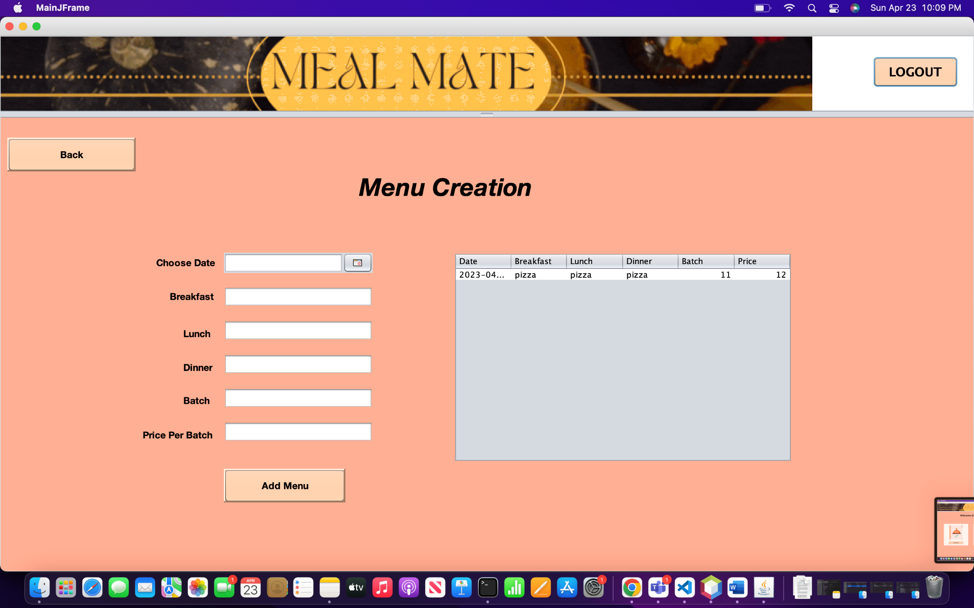
Menu creation

Slide 11
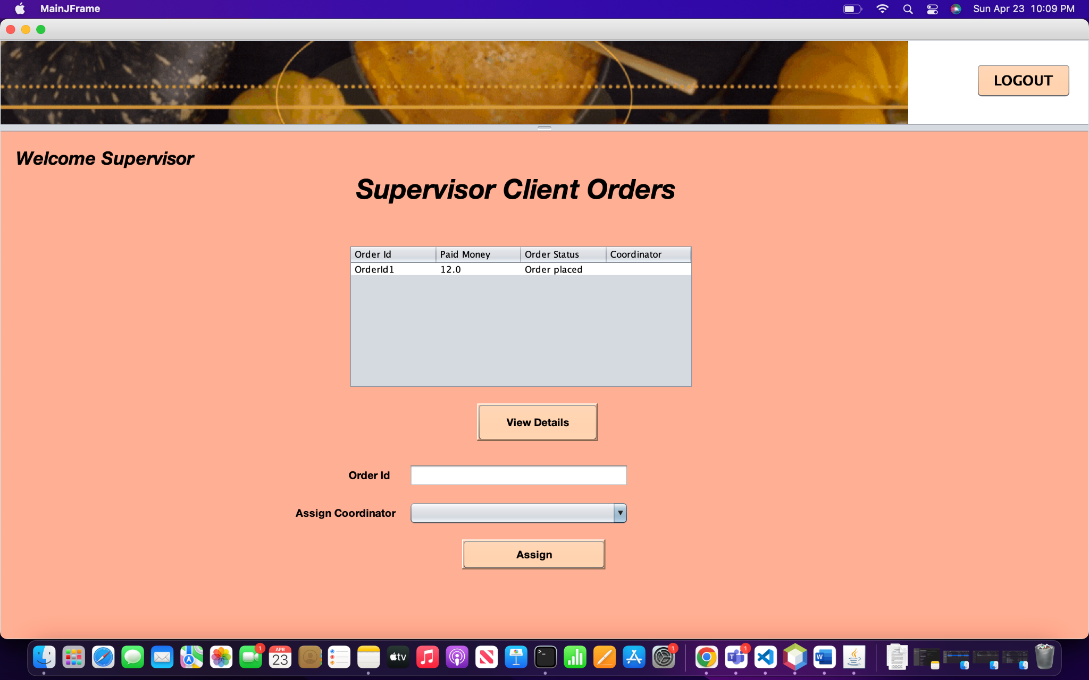
Order Placement

Slide 12
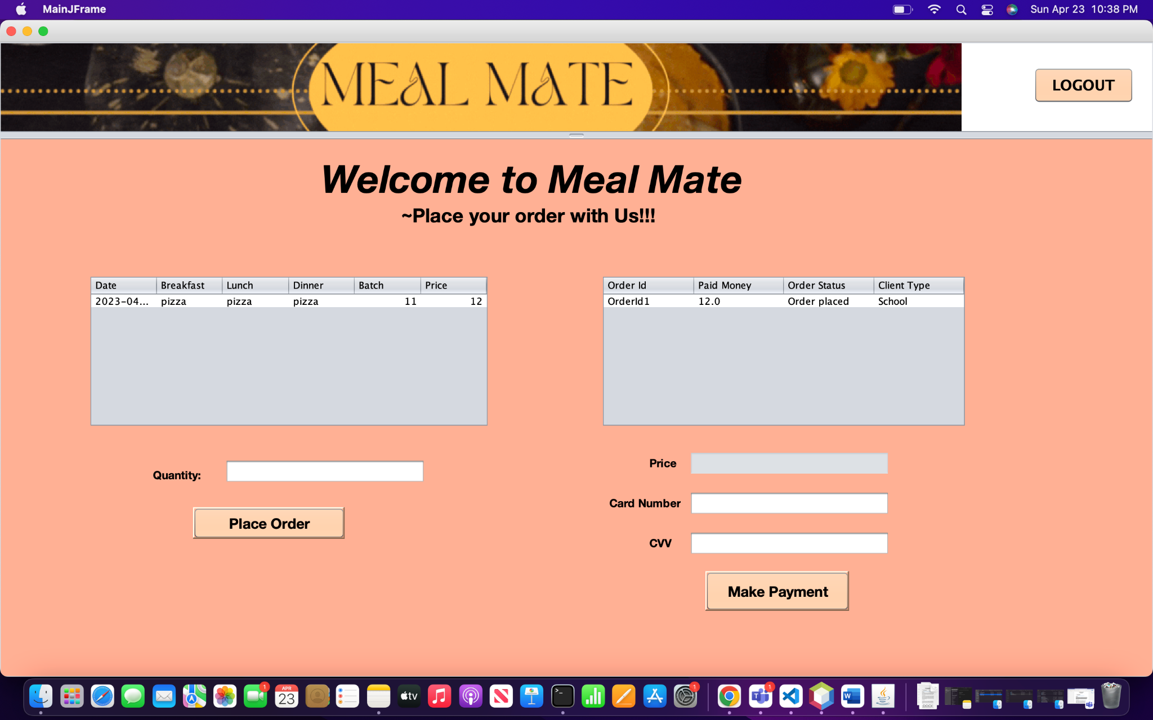
Client Work Area

Slide 13
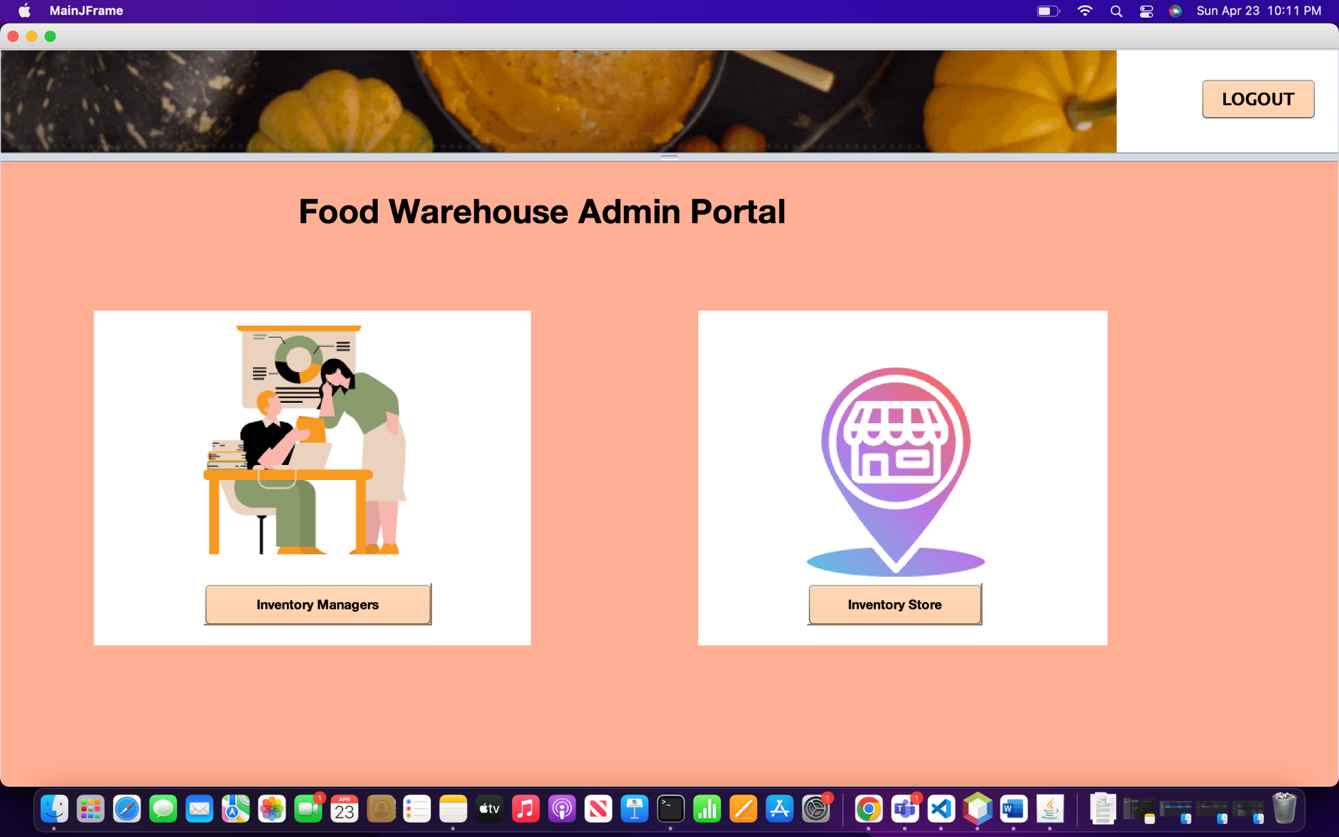
Warehouse

Slide 14
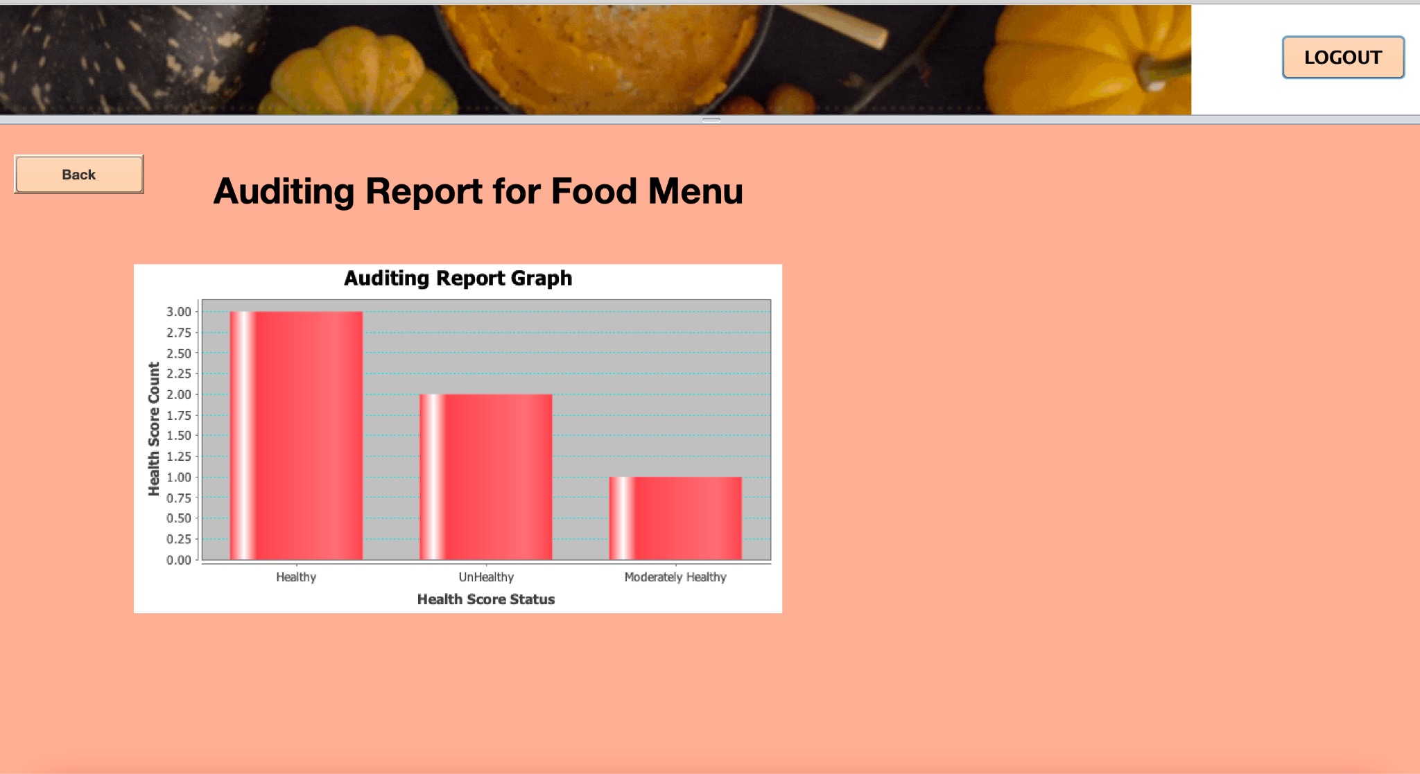
Auditing Report Graph

Slide 15
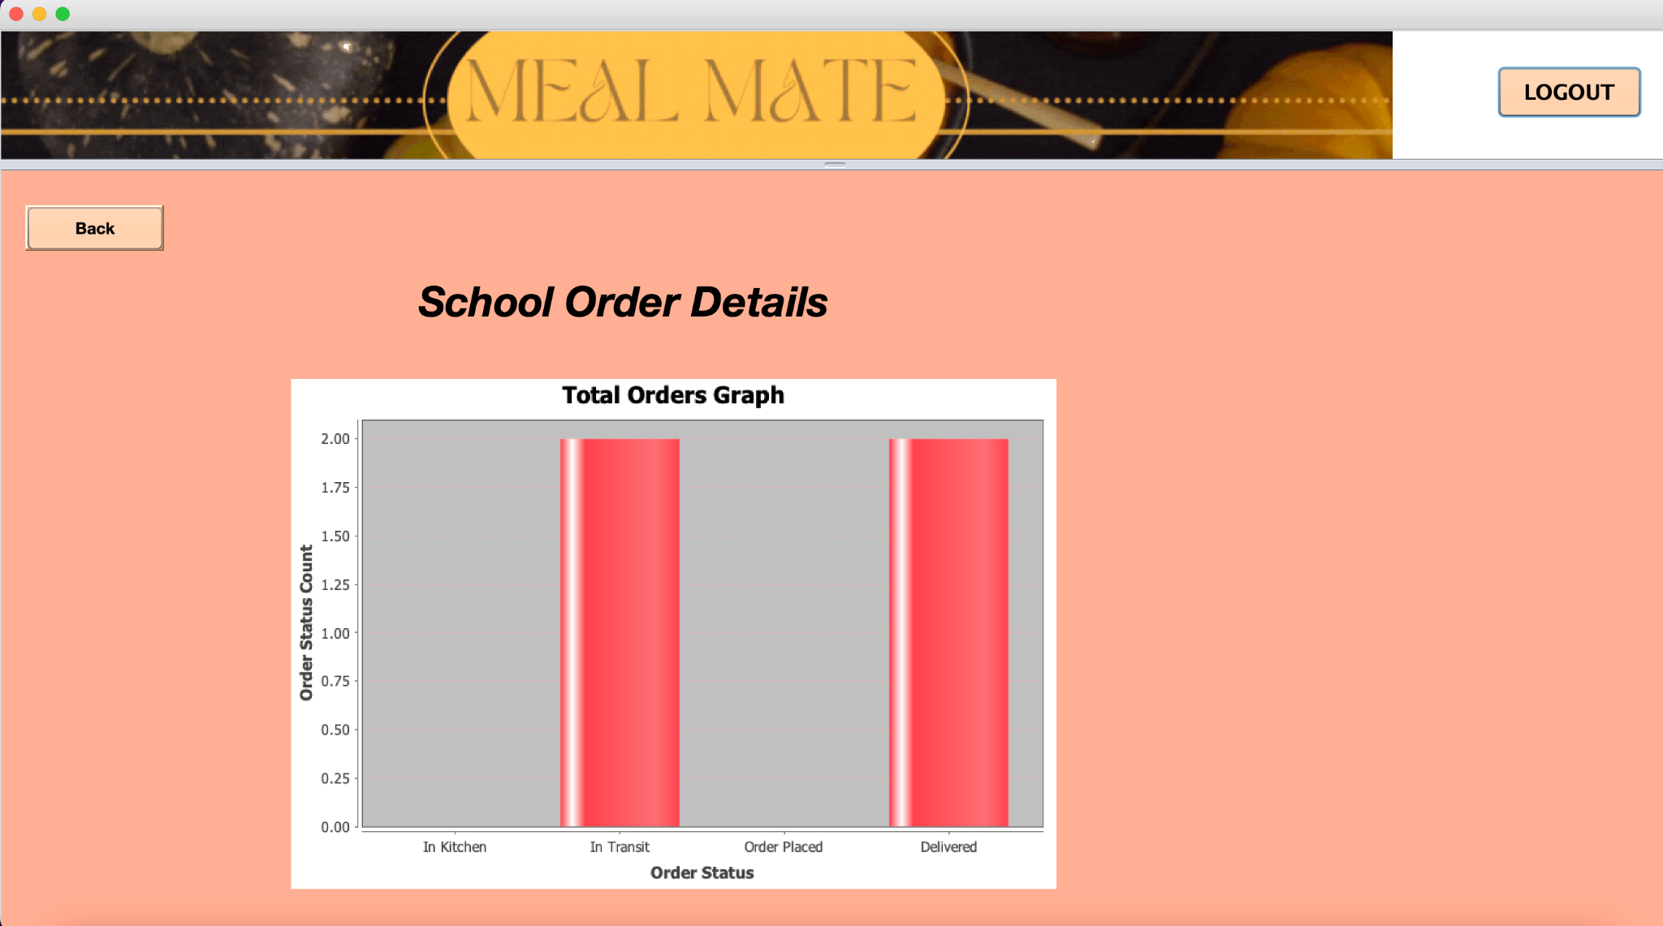
Order by Organization Graph

Slide 16
Thankyou!!!
Mrunali Pawar(002646797)
Nishi Pancholi(002620349)
Jeel Kanzaria(002652655)

